Slide 1

R-Girls-School Network
Razia Ghani PhD
Head Teacher at Green Oak Academy, Birmingham UK

Slide 2





Overview
Background
Aims
Progress
Challenges
Help us

Slide 3




Slide 4
Mathematics & Statistics
SAS – pharma
Teaching Mathematics
Head Teacher

Slide 5
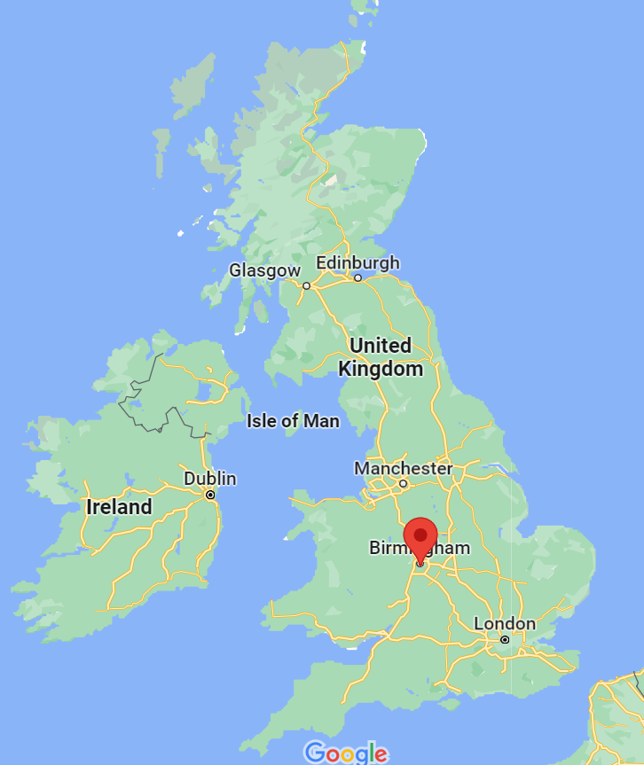

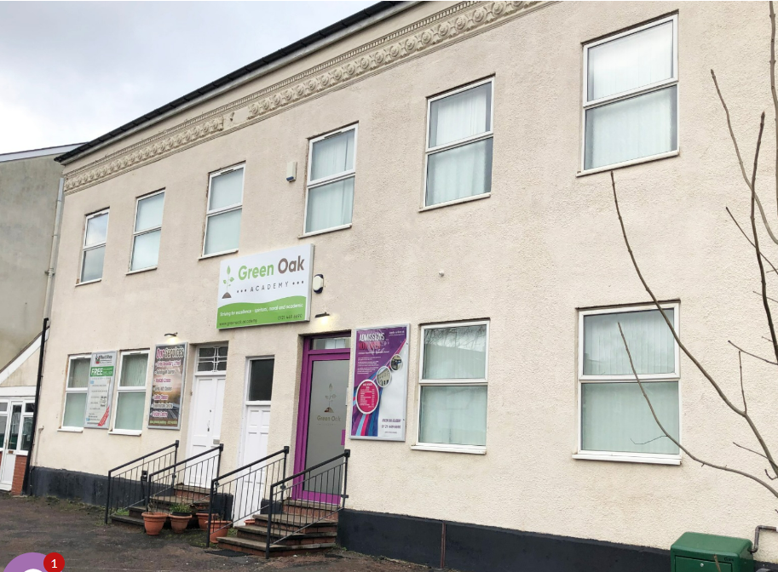





Birmingham
2nd largest 7th most deprived
Small school ~70 students - ethnically diverse
Quality of education
Behaviour and attitudes
Personal development of pupils
Leadership and management
Notes:
https://c8.alamy.com/zooms/9/715ca000f4994f0892404d72d7c7bf56/2bwf3wf.jpg

Slide 6
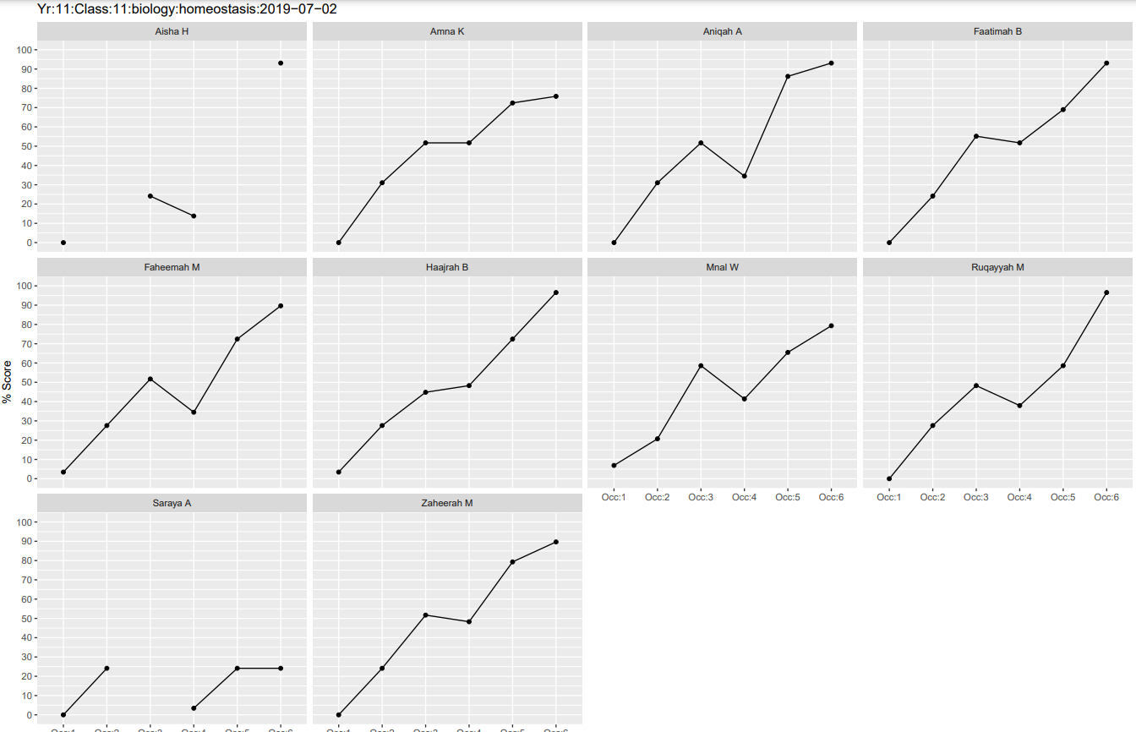
Student1
Student2
Student3
Student4
Student5
Student6
Student7
Student8
Student9
Student10

Slide 7




Bid
R-Consortium
Whacky idea – the joy of R
Supporters
Notes:
https://c8.alamy.com/zooms/9/715ca000f4994f0892404d72d7c7bf56/2bwf3wf.jpg

Slide 8

Background
Aims
Progress
Challenges
Help us

Slide 9
Aims
Promote
The use of R in secondary schools for girls
Inspire
Teachers to incorporate R into their lessons
Enable
Students to experience the joy of R

Slide 10

Background
Aims
Progress
Challenges
Help us

Slide 11




Lesson plans
Website
Twitter
Slack

Slide 12
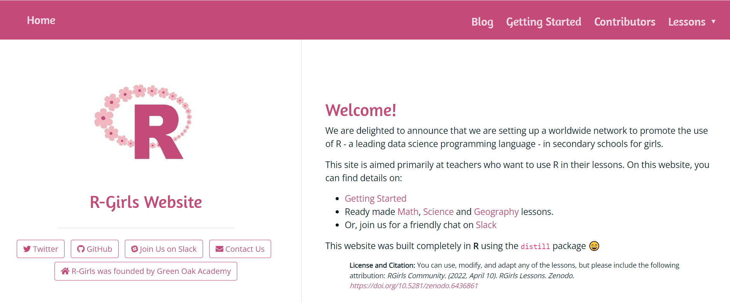
rgirls.org.uk

Slide 13
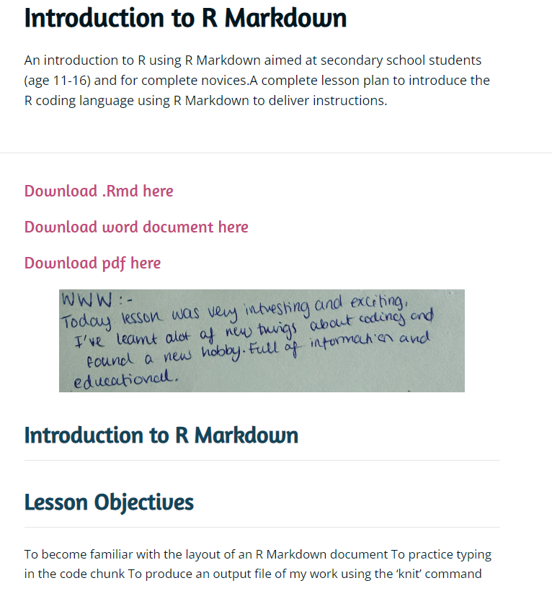
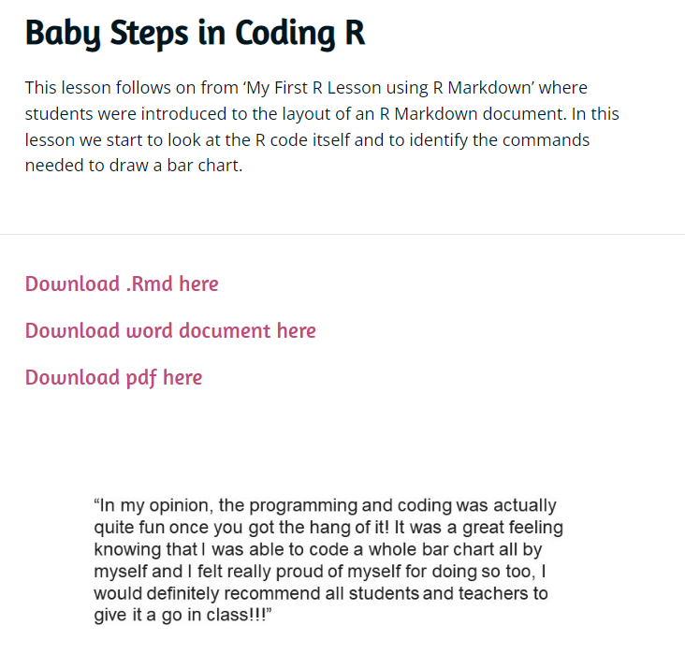

Slide 14
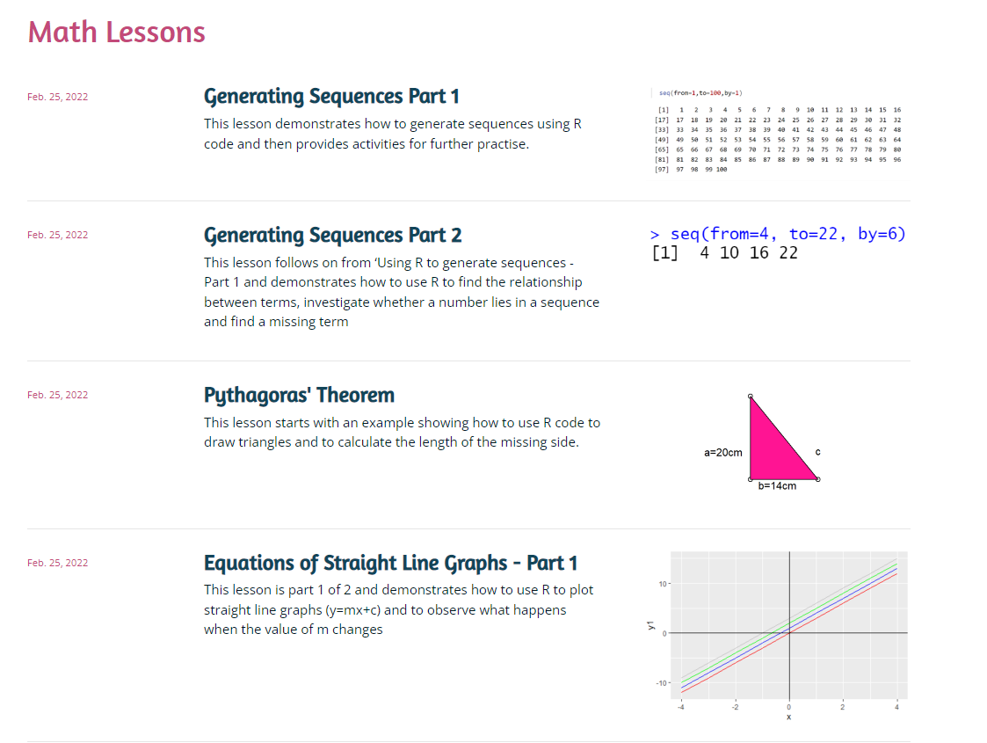

Slide 15
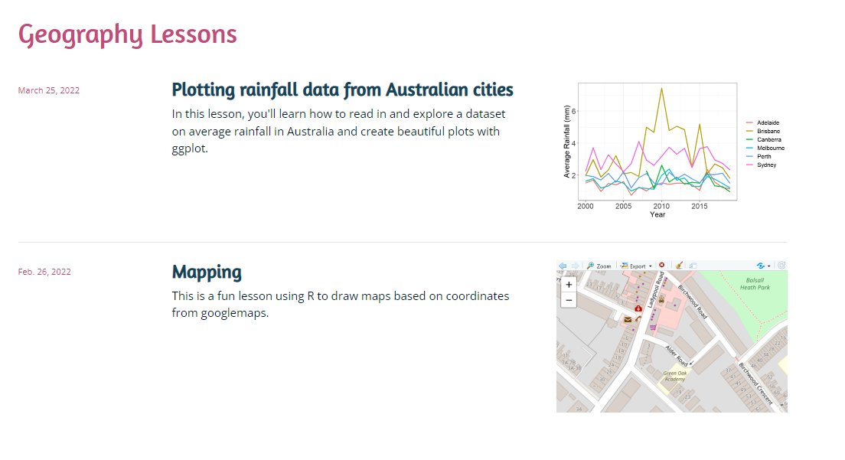

Slide 16
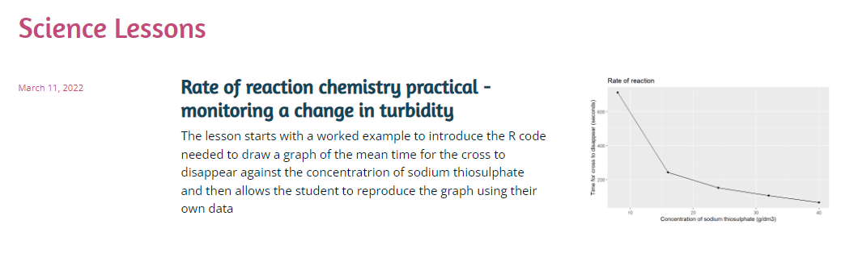

Slide 17
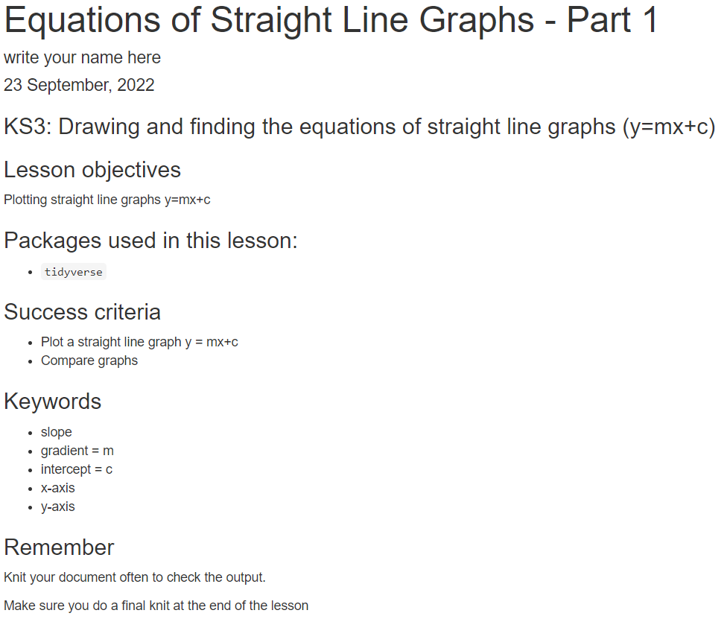
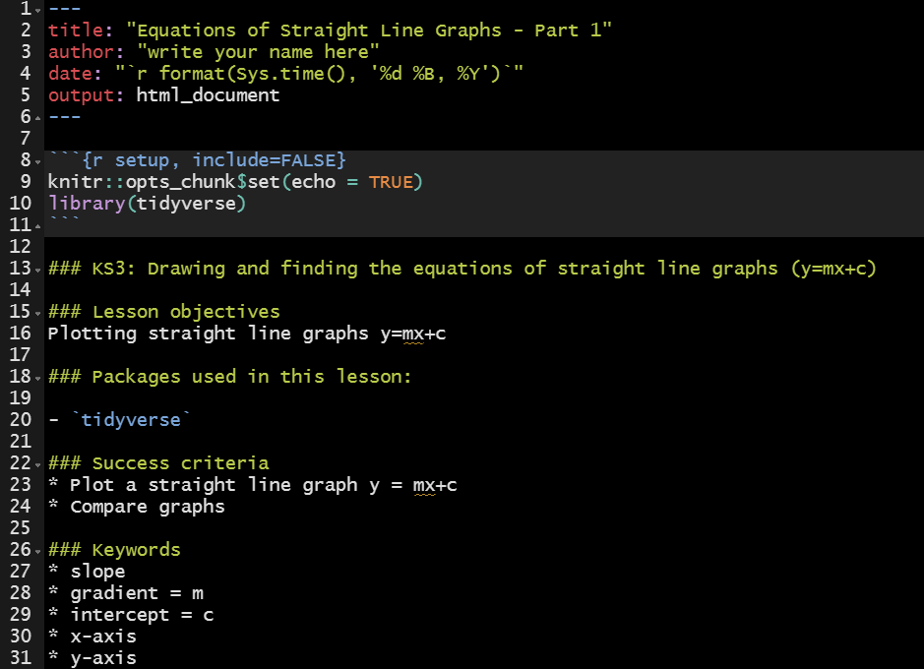

Slide 18
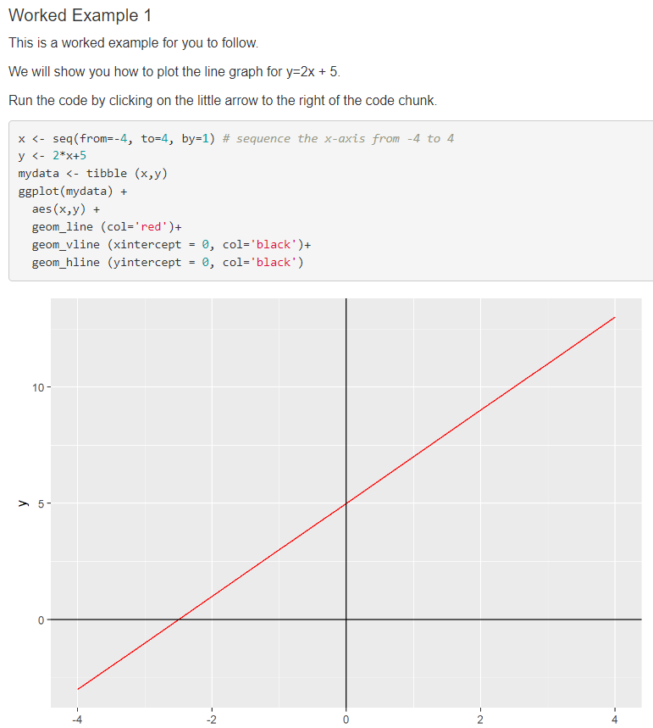
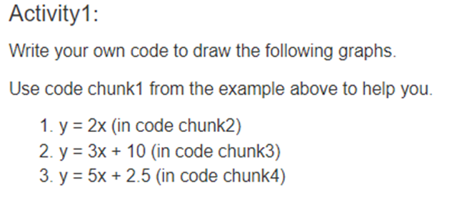

Slide 19
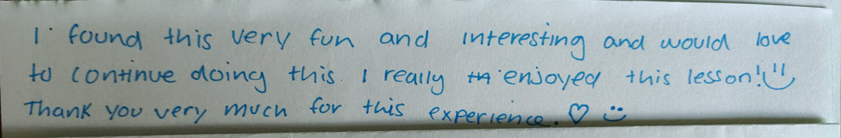
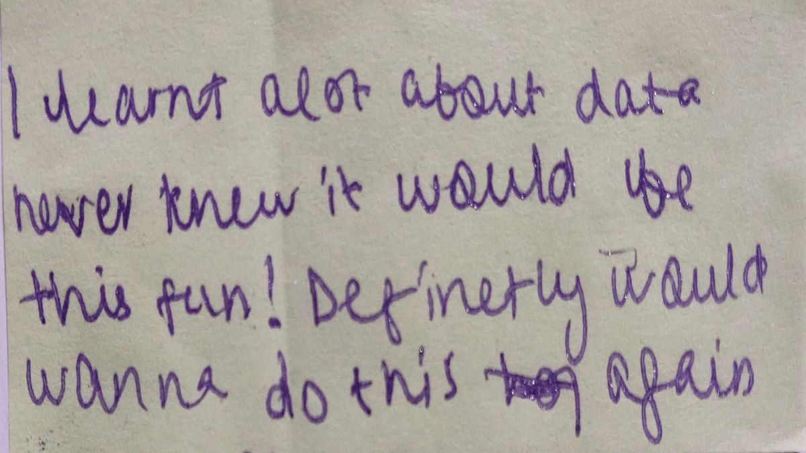
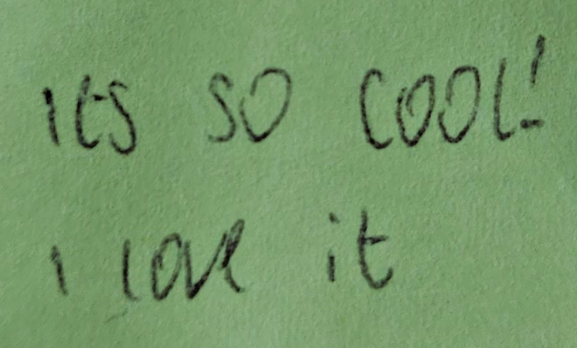
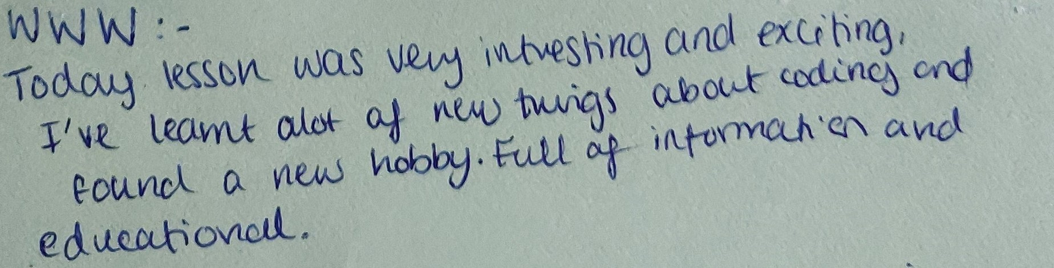


Slide 20
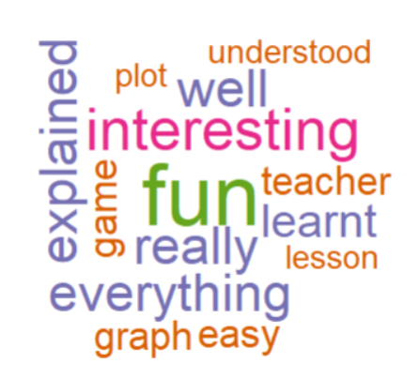
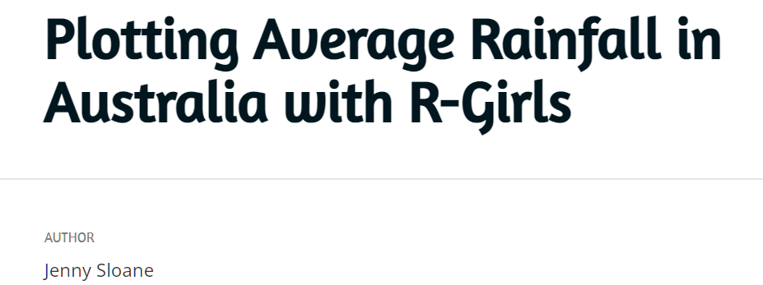
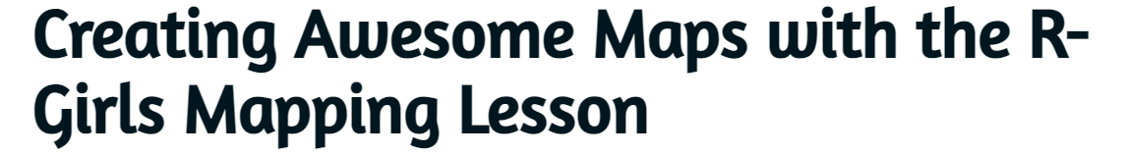

Slide 21
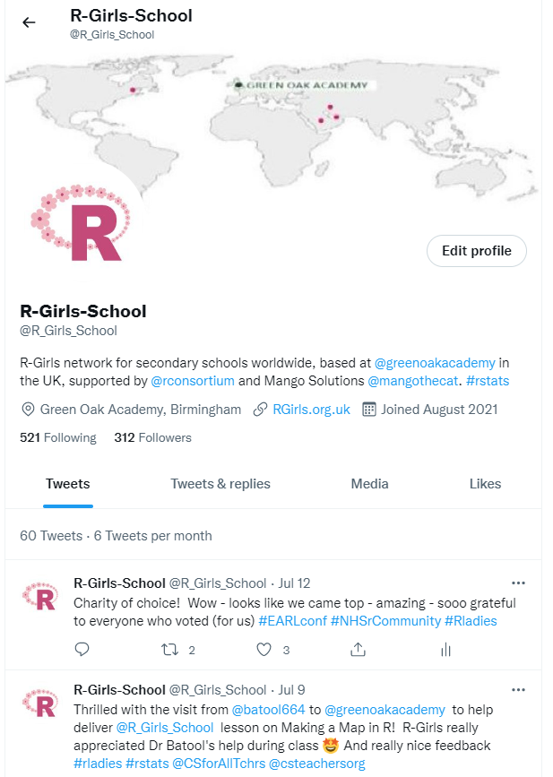

Slide 22

Background
Aims
Progress
Challenges
Help us

Slide 23


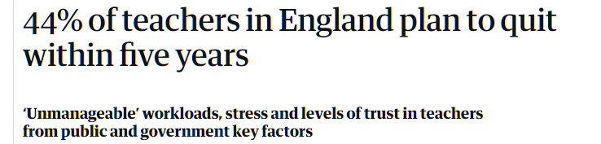



Notes:
https://www.theguardian.com/education/2022/apr/11/teachers-england-plan-to-quit-workloads-stress-trust

Slide 24





Nice Surprises

Slide 25
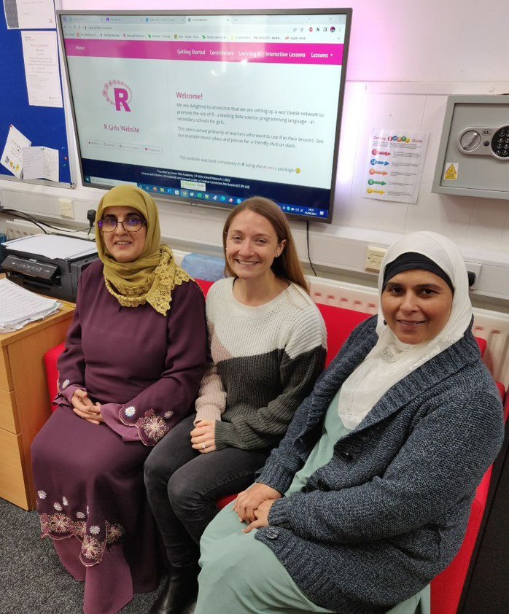

Slide 26

Background
Aims
Progress
Challenges
Help

Slide 27
Supporters & Contributors
Volunteers at Green Oak Academy & Educational Trust
R-Consortium
Ascent
R-Ladies
NHS-R
Jenny Sloane - website
Batool Almarzouq – interactive learnr lessons
Nasrin Fathollahzadeh Attar -blog
Iman Al-Hasani

Slide 28

Future Plans
Network with Teachers & Schools
Generate and Disseminate Lesson Plans
Annual R-Girls-School Conference
Sponsors

Slide 29

R-Girls-School Network
rgirls.org.uk
@R_Girls_School
r-girls.slack.com

